Slide 1

PRIEE PROJECT
JOB RECOMMENDATION SYSTEM CAREER GUIDANCE – AI ASSISTED
–Deepika SG(210701048)
–Gopika KV(210701063)

Slide 2
The problem
How might we create a skill/job recommender application using suitable technology,transforming career guidance by leveraging technology to match individuals with suitable jobs, fostering efficient employment and career development?

Slide 3
Abstract:
In the dynamic realm of corporate world, characterized by both competition and collaboration, the process of hiring has perpetually been discerning, presenting formidable obstacles for novices or recent graduates endeavoring to penetrate the professional arena. A newbie finds it so difficult to step in which is why we have a job recommender system which will find them find and pave their path into their desired job role using collaborative filtering and content filtering integrated with machine learning NLP concepts.

Slide 4

The solution
User Profile Creation
Skill Scraping and Analysis
Job Matching Algorithm
Integration with External Databases and provide user jobs he is eligible for or needs to develop.

Slide 5
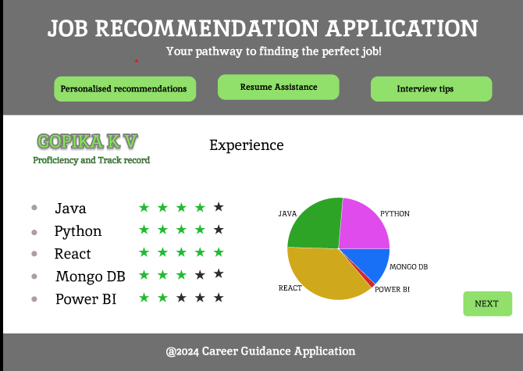
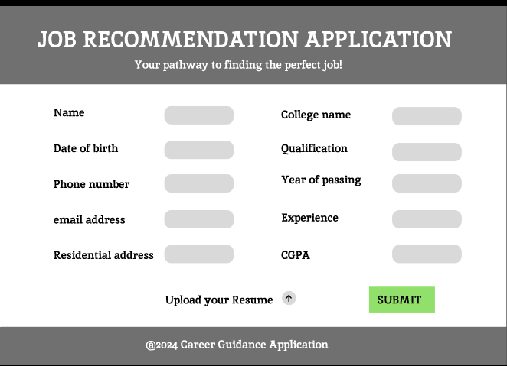
Step 3
Methodology used & How it works ?
Step 1: Know about User
Step 2: User details
Via forms
Present in UI

Slide 6
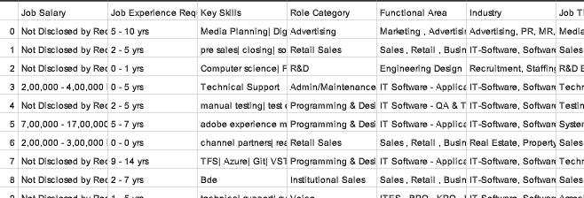
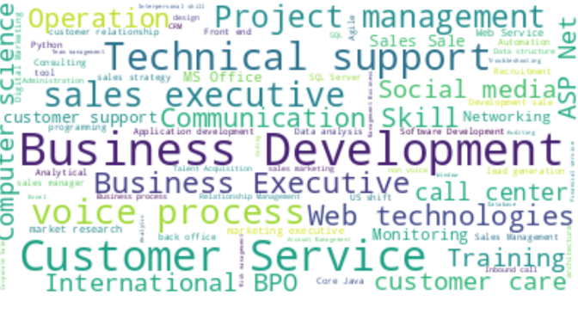
Step 3
How it works ?
Step 3: Pre-Stored data set
Step 4: Use “Stopword” to fetch only meaningful data ”NLP Conceots”
To compare with pre-stored job skills and position present

Slide 7
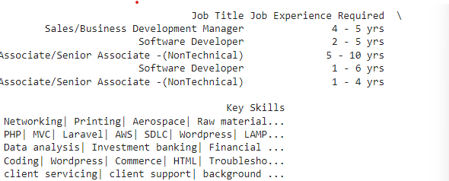
How it works ?
Step 5: To compare and filter out
By using Tfidvectorize and cosine_similarity compare and filter out.

Slide 8
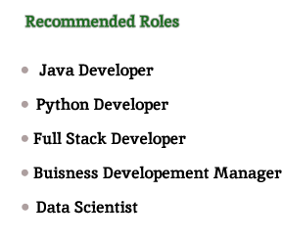
How it works ?
Step 5: Provide the list of roles user is eligible for
User can get the roles his resume has chances of getting selected.

Slide 9
Methodology Used:
Important methods used:
DATA PREPROCESSING:the process of detecting and correcting (or removing) corrupt or inaccurate records from a dataset.
NLTK “STOPWORDS”: a machine learning technology that gives computers the ability to interpret, manipulate, and comprehend human language, so that meaningful and only required information are fetched from the resume or the details user provided.

Slide 10
Methodology Used
TFID_VECTORIZER: term frequency-inverse document frequency ,a measure used in the fields of information retrieval (IR) and machine learning.
COSINE_SIMILARITY: Cosine similarity is the cosine of the angle between the vectors,Using that angle to compare and recommend the job roles or skill development.

Slide 11

Project output Screenshots

Slide 12
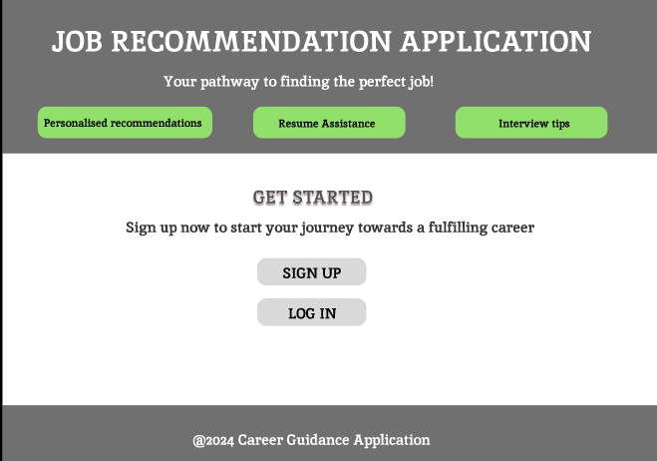
OUTPUT:
Sign in or log in page

Slide 13
OUTPUT:

Slide 14
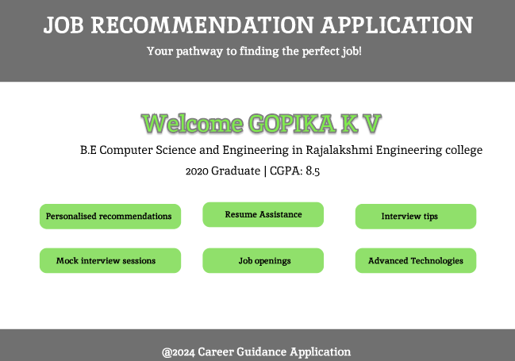
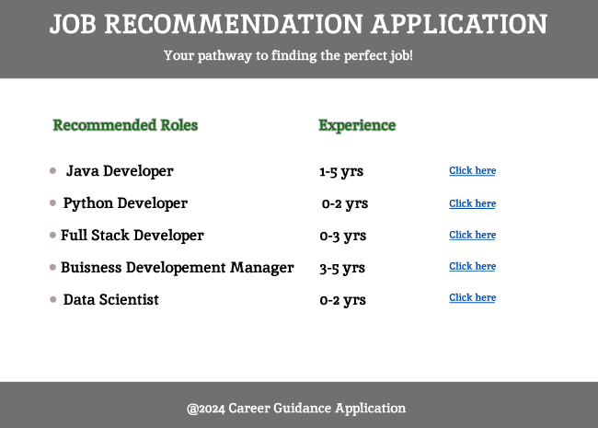
OUTPUT:

Slide 15
THANK YOU!

